Slide 1
GUS Gateway for UAMS Students
Program Director
Basic Training
gus.uams.edu oaa.uams.edu

Slide 2
Overview
OAA
OAA
GUS
CAS
SAP
BART
BART
Staging
GUS
CAS
SAP

Slide 3
Architecture
Career
Undergraduate, Graduate, Pharmacy, Medicine, PA
Academic Group (5 colleges and grad school)
Programs
Plans
Sub-Plans
Programs Plans Sub-Plans

Slide 4
OAA – Online Admissions Application
Applicant registers on OAA
Applicant creates application
CAS applicant creates supplemental OAA
Applicant submits application

Slide 5
OAA – continued
Applicant pays application fee
Applicant receives temporary login to GUS
Applicant uses GUS Self Service
Monitors to-dos
Accepts / Denies offer of admittance

Slide 6
OAA – Online Admissions Application
Registers OAA
Email
Thanks for your interest in UAMS
Submits
Application
OAA
OAA
Email
UAMS has
received Application
Email
Temporary GUS
UserID & Password
405 J!9
Monitors To-Dos
Accepts or Denies
405
GUS
J!9

Slide 7
OAA – continued
Signs Confidentiality Provides SS#
Email
UAMS Student Network
UserID & Password
Bob 8*Q
GUS
Forgets Confidentiality AND / OR
SS#
Signs Confidentiality Provides SS#
Email
Complete
one or both Confidentiality SS#
Email
UAMS Student Network
UserID & Password
Bob 8*Q
GUS

Slide 8
UAMS

Slide 9
From OAA to GUS Communications received from UAMS_Admissions@uams.edu
Register on OAA
– thanks for using OAA
Submit OAA Application
- we’ve received your application
- here’s your temporary userID & password
Accept Admission - Confidentiality Agreement & Social Security Number
- here’s your UAMS network ID & password
Accept Admission - Has NOT completed Confidentiality Agreement and/or Social Security Number
- you have not done one or the other of these requirements
1) Confidentiality Agreement
2) provide Social Security number
- Payment Receipt from Cybersource

Slide 10
OAA
Each college created application(s) based on Needs
COP
UAMS_PHARM
COM
UAMS_COM
COPH
UAMS_COPHG, UAMS_COPH_NDG

Slide 11
OAA continued
CON
UAMS_BSN, UAMS_DNP, UAMS_MSNC, UAMS_RN
GRAD
UAMS_CTS, UAMS_GRAD, UAMS_GRADND, UAMS_Nursing, UAMS_PHARMSCI, UAMS_REGSCI
CHP
UAMS_AUD, UAMS_CHP, UAMS_CHP_ND, UAMS_CSDMS, UAMS_DIET, UAMS_DPT, UAMS_GENETIC, UAMS_HEALTHINFO, UAMS_NMAA, UAMS_PA, UAMS_RAST

Slide 12
Student Self Service
To-Dos (checklists)
Confidentiality Agreement
Accept / Deny offer of Admission
Holds

Slide 13
Basic Navigation
DO NOT use the browser back arrow
Turn off browser pop-up blocker
Magnifying Glass provides a list of available values
Open more than one GUS window within a session
Open only one GUS session in the same browser

Slide 14
Basic Navigation
Sort on column headers
Use to combine data on tabs into One table
Always check for More than One

Slide 15
User Defaults
Create defaults that pre-populate certain values
Favorites
Create short cuts to frequently used pages / menues

Slide 16
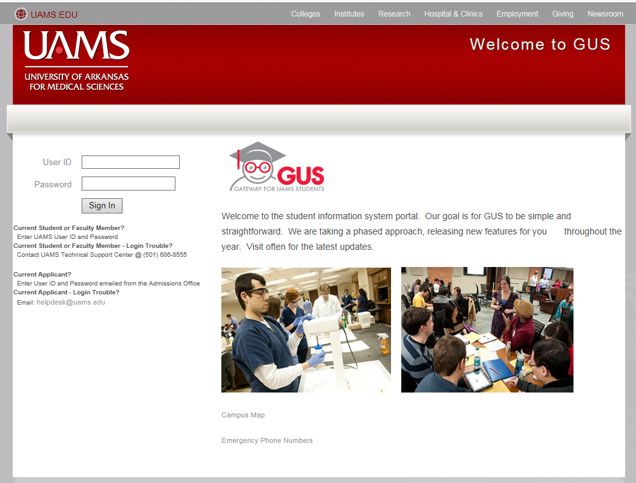
Portal Login

Slide 17
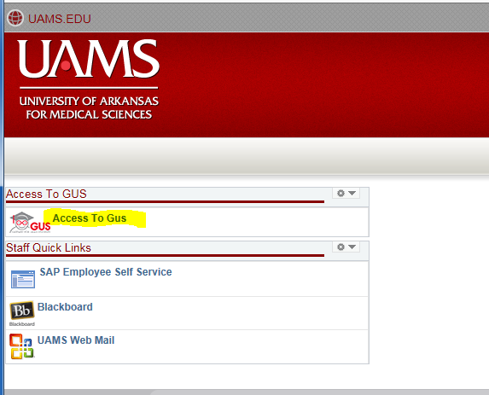
Access to GUS

Slide 18
Navigation to Query Viewer

Slide 19
Add Query Viewer to Favorites

Slide 20
Add UA_OAA_APPLS_ByPlan to Favorites

Slide 21
Complete Prompts

Slide 22
Application Number is Hyperlink

Slide 23
Application Data
File Attachments
Completed Application
Letters of Recommendation (if uploaded)
Other uploaded documents

Slide 24
Transfer to Educational data

